Slide 1

Język Go w świecie Cloud Computing.
Arkadiusz Galwas, SAP
3 listopada, 2020

Slide 2
Agenda
Przywitanie (5min ) – Artur
Wykład (75 min) – Arek
Q&A

Slide 3
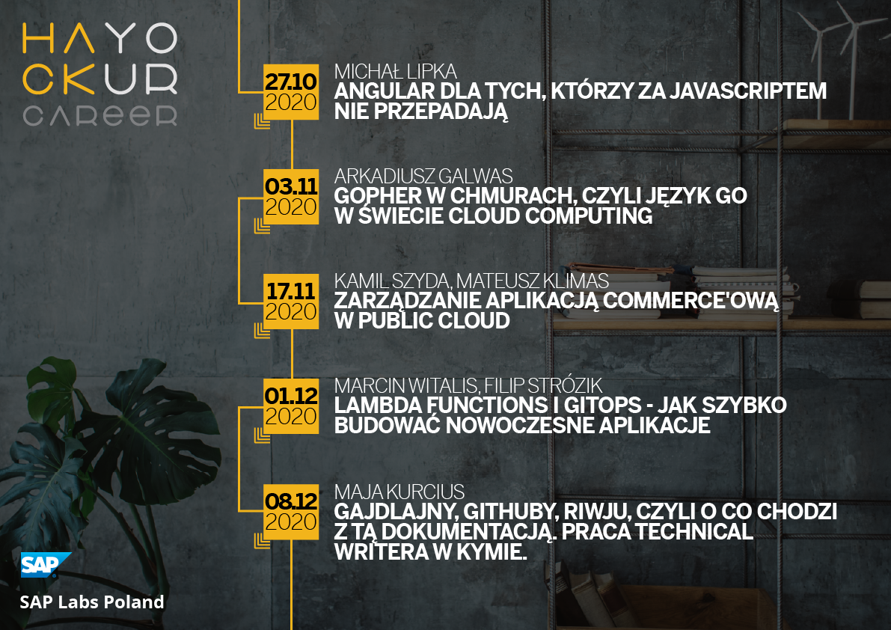
Hack Your Career
https://hackyourcareer.github.io/
https://www.facebook.com/Hack.your.Career/

Slide 4



SAP Labs Poland
Różnorodność domen
E-commerce, social commerce, cloud platform, open source,...
> 350 pracowników
Development: Go, Java, Angular, Cloud Native solutions, ...
Różnorodność specjalizacji
Product teams, project teams, innovation projects teams, support teams
Możliwość nauki i rozwoju:
Platformy do edukacji on-line, certyfikacje, łatwy dostęp do ekspertów na całym świecie
Jedno z 21 centrów
SAP’s Labs Network

Slide 5
Hack Your Career
Dla zainteresowanych programowaniem w GO, chmurach i pracą z nami:
https://jobs.sap.com/job/Gliwice-Cloud-R&D-Developer-at-SAP-Labs-Job-SL/629171801/
(skrót: https://url.sap/t3ksa7)
Aktualne oferty pracy:
https://jobs.sap.com/search/?locationsearch=gliwice
(skrót: https://url.sap/3vywdy)
Śledź nas na:
https://hackyourcareer.github.io/
https://www.facebook.com/Hack.your.Career/

Slide 6

Arkadiusz Galwas, Senior Software Engineer, SAP Labs Poland.

Slide 7

Go in the world of Cloud Computing
What is the Cloud?
Cloud language requirements.
Go features overview.
Go in action.
Summary.

Slide 8

What is the Cloud?

Slide 9
What is the Cloud?
Cloud computing is the on-demand availability of computer system resources, especially data storage (cloud storage) and computing power, without direct active management by the user.
The term is generally used to describe data centers available to many users over the Internet.
Source: https://en.wikipedia.org/wiki/Cloud_computing

Slide 10
What is the Cloud?

Slide 11
What is the Cloud?
Benefits of Cloud Computing for software developers:
Ability to respond to increasing or decreasing computing resources demand.
Computing resources cost proportional to workload size.
Lower overall infrastructure maintenance cost.
Geographical distribution.

Slide 12

Cloud language requirements

Slide 13


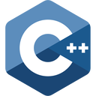
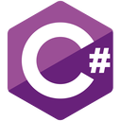








Which programming language should I use for cloud projects?

Slide 14
Cloud language requirements.
The most important qualities include:
Libraries and tools.
Performance.
Speed of development.
Resource utilization.

Slide 15

Go features overview

Slide 16
Go features overview: design philosophy
The computing landscape today is almost unrelated to the environment in which the languages being used, mostly C++, Java, and Python, had been created. The problems introduced by multicore processors, networked systems, massive computation clusters, and the web programming model were being worked around rather than addressed head-on.
Rob Pike, Go at Google: Language Design in the Service of Software Engineering

Slide 17
Go features overview
Go is:
Statically typed.
Compiled to native code.
Multiparadigm (procedural, sort of OOP, elements of FP).
Easy to learn.

Slide 18
Go features overview
Go has:
Automatic memory management.
Concurrency mechanisms built-in.
Rich standard library and tooling.
Large ecosystem of Open Source libraries.

Slide 19
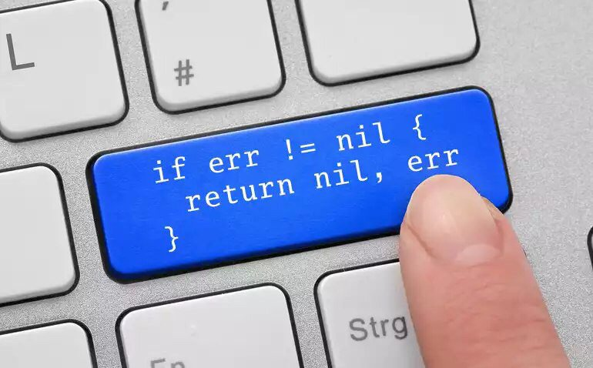

Go features overview
What Go lacks:
Classes
Inheritance
Generics
Exceptions handling
Yep.
No exceptions???

Slide 20

Go features overview
C++, Java, Scala, Rust etc.
Go

Slide 21

Go in action

Slide 22
Go in action
Basic Go.
Concurrency.
REST service and Google Cloud Run.
Serverless with Google Cloud Functions.

Slide 23
Summary

Slide 24
Summary
Go has features that make it suitable for the Cloud:
Good concurrency suport.
Rich ecosystem: tooling and Open Source libraries.
Reasonable performance and memory consumption.
Reasonable speed of development.

Slide 25
Summary
Go is good for:
Writing complex Cloud infrastructure projects.
Writing small command line tools (e.g. for DevOps and Penetration Testers).
Writing microservices and Serverless Functions.

Slide 26

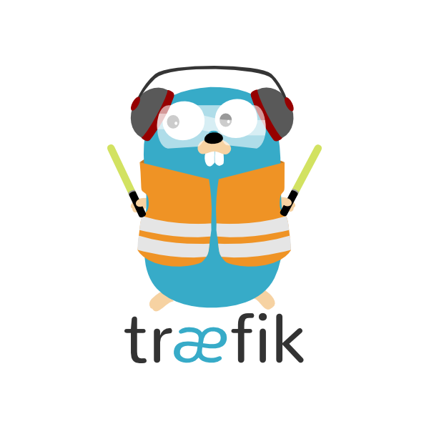

Summary: Go adoption

Slide 27
Questions?

Slide 28
Hack Your Career
Dla zainteresowanych programowaniem w GO, chmurach i pracą z nami:
https://jobs.sap.com/job/Gliwice-Cloud-R&D-Developer-at-SAP-Labs-Job-SL/629171801/
(skrót: https://url.sap/t3ksa7)
Aktualne oferty pracy:
https://jobs.sap.com/search/?locationsearch=gliwice
(skrót: https://url.sap/3vywdy)
Śledź nas na:
https://hackyourcareer.github.io/
https://www.facebook.com/Hack.your.Career/

Slide 29
Thank you.

